Slide 1
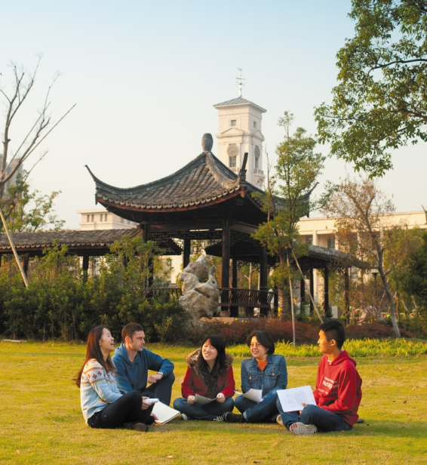

Oral Communication Skills B
(CELEN082)
Lesson 1.2

Slide 2
Lesson aims and objectives
Receive peer and tutor feedback on your possible OCSb presentation title. Be introduced to the requirements of the ‘Research Poster’ task.

Slide 3
OCSb Presentation titles

Slide 4
OCSb Presentation titles: Peer feedback
In your group, tell each other your possible presentation titles.
Decide who has the most interesting presentation topic. Why?
Give each other feedback using the three criteria from Lesson 1.1:
Is the topic specific enough? Can the student cover the topic fully in 8-11 minutes?
Will the student be able to find sources about this topic that are written in English?
Does the presentation title identify a problem and indicate that the student will present solutions for it?

Slide 5
OCSb Presentation titles: Peer feedback
Analyse the presentation titles of your classmates that your tutor has selected and decide whether they are EFFECTIVE or NOT EFFECTIVE.
For the titles that are NOT EFFECTIVE, think of advice for the student about how they can improve their title.
EFFECTIVE | NOT EFFECTIVE

Slide 6
Research Poster Task

Slide 7
Research Poster: Requirements
Once you have selected a title, the next stage of your presentation preparation process is to start gathering information. Your ability to do this successfully will be assessed in the Research Poster event.
In Lesson 5.1, you will display your poster on the class wall. You will stand next to it and answer questions from your peers and your OCSb tutor.
The poster should contain information from THREE sources that you have found for your OCSb presentation:
ONE book
ONE journal article
ONE newspaper article or website

Slide 8
Research Poster: Requirements
The poster should contain information from THREE sources:
ONE book
ONE journal article
ONE newspaper article or website
Discuss.
What are the differences between the three types of sources (e.g. audience, content, style)?
Why do you think you are expected to look for these types of sources?

Slide 9
Research Poster: Requirements
Book
In an academic context, books are written to inform or educate.
Textbooks, in particular, can help you gain a general understanding about a specific subject.
Note: A thesis / report is not a book (even if has a lot of pages).
Journal article
Journal articles are academic texts that generally aim to share or review research findings. They are peer reviewed and aimed at academics.
They are useful for finding specific data to support your ideas.
Newspaper article / Website
Newspaper articles are aimed at a broader audience. They are usually online.
They are great for learning about current issues in a particular area.
Note: Some newspapers contain the word ‘journal’ in the name, but they are not the same as academic journal articles.

Slide 10
Research Poster: Sample
Analyse the sample poster on the next slide, and complete the tasks below:
Identify five types of information that need to be included on your poster.
Consider how you should present text (e.g. paragraphs, sentences) on your poster and identify one reason for this.

Slide 11
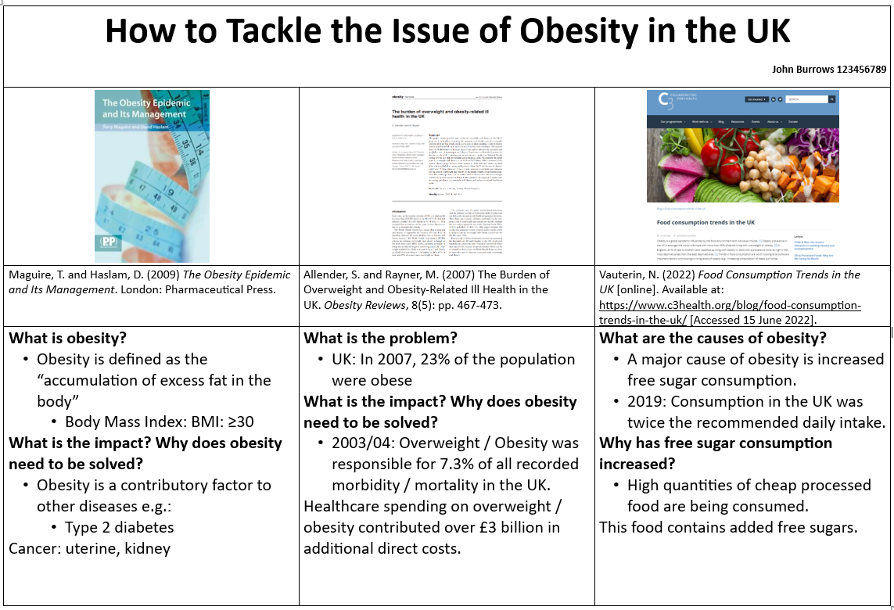
The title of your presentation
Your name and ID number
Images of your sources showing the title
Your research questions and information from the sources that answer the questions (as bullet points).
The reference for the source

Slide 12
Research Poster: Requirements
Your poster must contain information on THREE sources related to your topic:
ONE book
ONE journal article
ONE newspaper article or website
You must print one copy of the poster for the Research Poster event. The poster must be A3 in size. You must also submit a copy of the poster via Moodle.
During the Research Poster event, your OCSb tutor will be evaluating you on the APPROPRIATENESS of your sources and their RELEVANCE to your Final Presentation topic.
We will work on how to find appropriate sources in Lesson 2.2.
We will work on how to deal with questions during the Research Poster event in Lesson 3.2.

Slide 13
Homework
Due | Task
Before Lesson 2.1 | Work on finalising your OCSb Presentation title. Share it on the class Team.
Lesson 2.1 | Think about a problem that currently exists in your society (e.g. children spend too much time on social media). Do a little research and make notes so you can explain this problem to your classmates.
Self-Study
Find the sample Research Poster and the Research Poster template on the OCSb Moodle page.

